Slide 1



CyberDefend : Fighting Cybercrime Using Machine Learning
Gaurang Patil​ - 1814046
Gopalkrishna Waja ​- 1814062
Charmee Mehta ​- 1924003
Guide: Dr. Sonali Patil

Slide 2
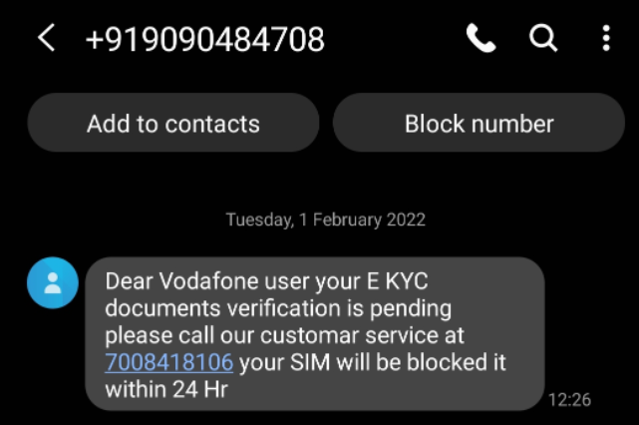


INTRODUCTION
"98% of cyber-attacks rely on social engineering."
Trick users into divulging sensitive information
Facilitate financial fraud
SMiShing campaign impersonating network service provider

Slide 3
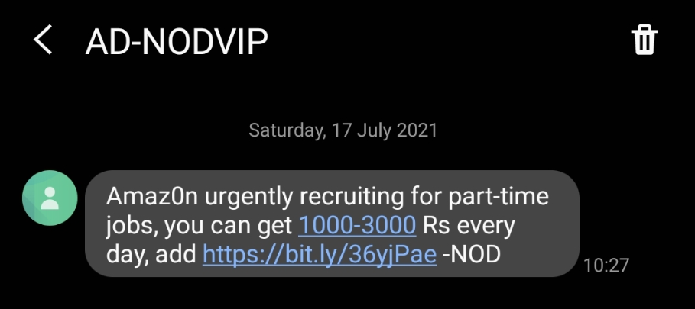
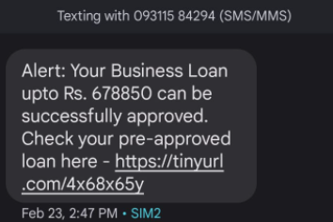
INTRODUCTION
Spam SMS
+
Social engineering tactics
+
Malicious URL
=
Malware installation on device
OR
Phishing scam

Slide 4


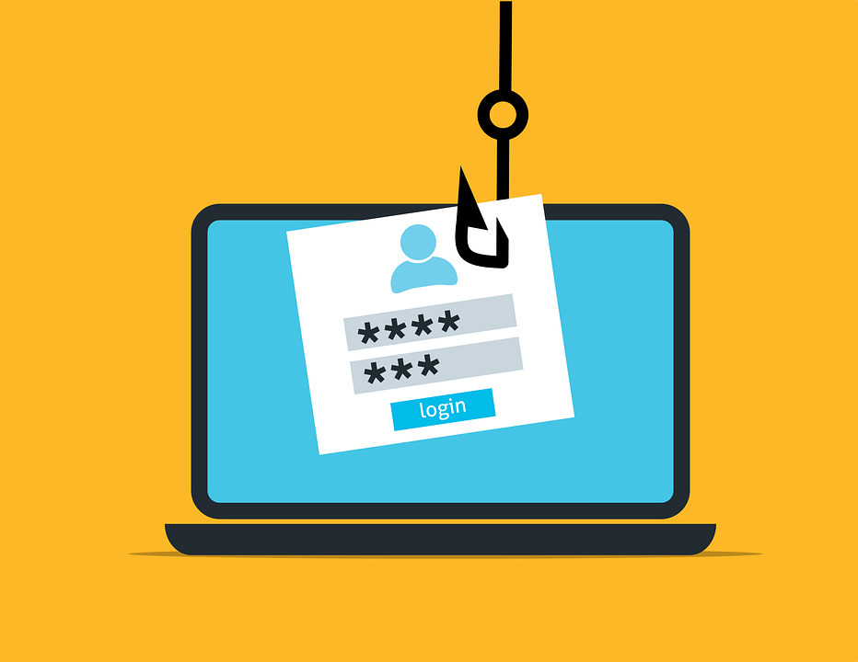

INTRODUCTION
URL blocklists and their limitation w.r.t.
zero-day attacks.
2020: Phishing URLs increased by 640%

Slide 5
PROBLEM DEFINITION AND PROJECT OBJECTIVES
Over the past decade cyber-crimes have been on a rise and as per The Hindu dated 9th March 2021, over 3.17 lakh cyber-crimes have been reported in India in just 18 months. This alarming increase in cyber-crimes requires to be addressed immediately by building an intelligent tool for the public to aid them in detection and prevention of common cyber-attacks by leveraging machine learning and deep learning techniques.
Objectives:-
Developing a Spam message detector with a built-in malicious URL detector.
Developing a Safe Search functionality to prevent visits to dangerous webpages.
Discovering past visits to dangerous websites using browsing history uploaded by the user.

Slide 6
FUNCTIONAL AND NON-FUNCTIONAL REQUIREMENTS
FUNCTIONAL REQUIREMENTS​ | NON-FUNCTIONAL REQUIREMENTS​
Spam message detector with inbuilt URL multiclass classifier.​ | Security: Input sanitization​
Safe Search to prevent visits to malicious / spam / phishing webpages.​ | Portability : Web application- access via desktop/laptop through browser.
Discovery of past visits to malicious websites using browser history uploaded by the user ​ | Availability : All round availability via deployment on cloud.

Slide 7
LITERATURE SURVEY
About the paper​​ | Paper [1] discusses multi-class URL classification using boosting Ensemble learners and work done in this paper can be used by us to implement feature 2 & 3.​​ | Paper [3] utilizes NLP in combination of a stacking ensemble learning techniques for spam classification and the study done here will be augmented by us to implement feature 1. ​
Methodology​​ | Extract 18 lexical and mathematical features like length, entropy etc. from 1,26,983 URLs belonging to 4 classes Benign, Phishing, Malware and Spam and used these features to train XgBoost, AdaBoost, CatBoost, LightGBM models.​​ | Utilized BOW and TF-IDF for vectorization for feature extraction and then an ensemble learner using hard voting consisting of 7 models i.e. Multinomial Naive bayes (MNB),Logistic regression (LR), SVM, nearest centroid center (NCC), Xgboost, KNN and perceptron. ​
Results​​ | Received the best result with AdaBoost and XGBoost. Also, the detection accuracy for benign, phishing, and malware was greater than 0.96, but that of spam was comparatively low at around 0.85.​​ | Received an overall accuracy of 97% and the results obtained by BOW and TF-IDF were comparable with BOW giving slightly better results, but the authors caution us that the results cannot be generalized unless the model is tested on some other datasets ​
Our Comments​ | Feature engineering can be done for suspicious extensions to build more discriminative features.​ Can use ML models with blocklists in tandem.​ | TF-IDF and BoW do not take into consideraton semantic information. ​ Unlikely to generalize well. Small datasets: non-spam messages do not include messages from banks, service providers. ​

Slide 8
PROPOSED IDEAS
Proposal for Spam Message Detection​​
Use personally collected spam messages involving smishing, scams, promotions etc. ​​
Use personally collected non spam messages related to transactions from banks, network service providers etc.​
Advanced vectorization techniques like Word2Vec or GloVe.​
Multichannel CNN architecture for automated feature extraction. ​
Proposal for URL Classification​​
Multiclass classification:​ Safe / Spam / Phishing / Malware​
Features:​ Lexical + JS based + HTML based​
Feature engineering for file extension- based features to make more discriminative models.​
Test XGBoost, Adaboost, Random Forest models.​
URL blocklist + ML models = Enhanced security​

Slide 9

TECHNOLOGY STACK
Frontend
HTML
CSS
JavaScript
Bootstrap
Backend
Streamlit
API
Google Safe Browsing Lookup
Training and Testing of models
Python
Google Colaboratory

Slide 10
DATASET DESCRIPTION
Task​ | Category​ | Dataset Source​ | Number of Samples​ | Total​
​ ​ URL Multiclass Classification​ | Safe​ | DMOZ ​ | 15,000​ | ​ ​ 48,502​
 | Spam​ | UNB​ | 11,999​
 | Phishing​ | PhishTank​ | 11,500​
 | Malware​ | URLhaus​ | 10,003​
​ ​ Spam Classification​ | ​ Spam​ | UCI ​ | 653​ | ​ ​ 8,751​
 |  | Self-collected​ | 2,429​
 | ​ Not-Spam​ | UCI​ | 4,516​
 |  | Self-collected​ | 1,153​

Slide 11
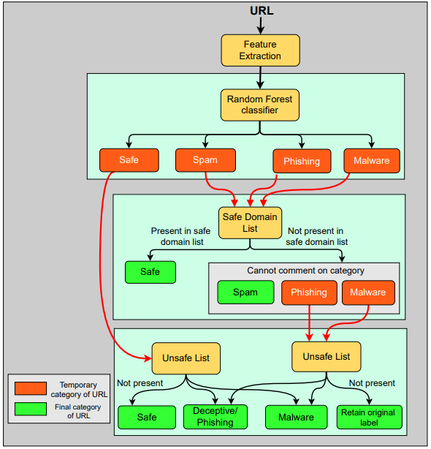
SYSTEM IMPLEMENTATION – URL CLASSIFIER

Slide 12
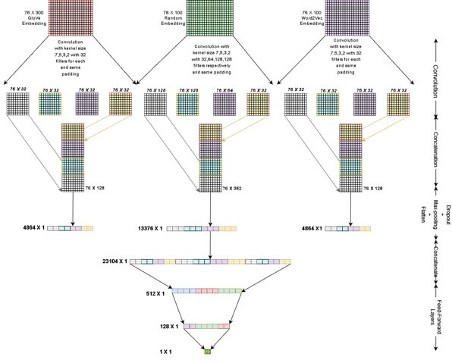
SYSTEM IMPLEMENTATION – SPAM CLASSIFIER

Slide 13
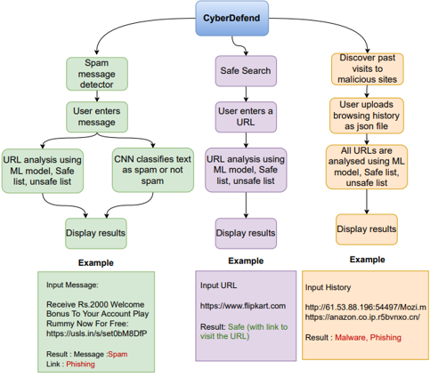
SYSTEM IMPLEMENTATION – WEB APP

Slide 14
RESULTS- SPAM CLASSIFIER
Convolution layer arrangement​ | Number of channels​
 | 1​ | 2​ | 3​
In Parallel​ | M1P​ | M2P​ | M3P​
In Series​ | M1S​ | M2S​ | M3S​
Variant Model​ | ​Channel​ | Training​ Accuracy​ | Testing Performance Metrics​
 |  |  | Accuracy​ | Recall​ | F1 score​
M1S​ | Random​ | 0.9943​ | 0.9509​ | 0.8922​ ​ | 0.9327​
M1P​ | Random​ | 0.9945​ | 0.9566​ | 0.8938​ | 0.9410​
M2S​ | Random + Word2Vec​ | 0.9935​ | 0.9532​ | 0.9000​ | 0.9354​
M2P​ | GloVe + Random​ | 0.9949​ | 0.9532​ | 0.8860​ | 0.9366​
M3S​ | GloVe + Random + Word2Vec​ | 0.9924​ | 0.9566​ | 0.8938​ | 0.9410​
M3P​ | GloVe + Random + Word2Vec​ | 0.9957​ | 0.9612​ | 0.9045​ | 0.9469​

Slide 15
RESULTS- URL CLASSIFIER
​ ML Model​ | Testing accuracy ​
 | With features ​ (taken from different papers​ /sources)​ | ​ After Feature Engineering​
Random Forest​ | 0.9371​ | 0.9469​
XGBoost​ | 0.9353​ | 0.9445​
Adaboost​ | 0.7888​ | 0.8168​
Features built using feature engineering​
Possibly malicious File Extension present in URL​ ( .m, .a, .i, .sh, .exe )​
HTM file Extension present in URL​ ( .htm )​
HTML file Extension present in URL​ ( .html )​
PHP file extension present in URL​ ( .php )​

Slide 16
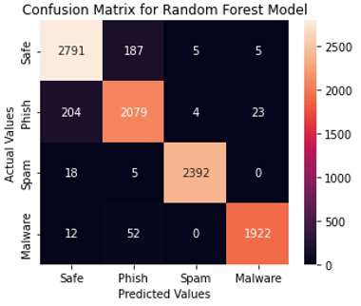
RESULTS- URL CLASSIFIER
Category​ | Categorical Accuracy​
Safe​ | 92.26 %​
Phishing​ | 89.5 %​
Spam​ | 99.63 %​
Malware​ | 98.56 ​%

Slide 17
SOFTWARE TEST DOCUMENT
Functional Testing
Functional testing of all features - manual testing.
Text field validation
Compatibility Testing
OS tested include Windows (10,11), MacOS Catalina
Browsers include Chrome, Firefox and Edge.
Usability Testing
Testing done using GTmetrix. Overall score is 81 %
Good results in most performance metrics
Appropriate Error messages
Testing done using SauceLabs
Cumulative layout shift and speed index can be improved

Slide 18
CONCLUSION
Tool can help counter zero-day phishing attacks spreading through malicious URLs.
Useful in detecting-
Spam messages / Social engineering attacks
+
Malicious URLs
Limitations of the work
1. Tool needs to be tested in production, not just experimental setups.
2. Cannot assure 100% safety :
More data, better models.
Possible solution: Tie up with civil defense authorities to work on building better models.
3. Scope for improvement in detecting phishing and safe URLs

Slide 19

REFERENCES
[1] T. Manyumwa, P. F. Chapita, H. Wu and S. Ji, Towards Fighting Cybercrime: Malicious URL Attack Type Detection using Multiclass Classification; 2020 IEEE International Conference on Big Data (Big Data), 2020, pp. 1813-1822, doi: 10.1109/BigData50022.2020.9378029.
[2] Rishikesh Mahajan and Irfan Siddavatam, Phishing Website Detection using Machine Learning Algorithms; International Journal of Computer Applications 181(23):45-47, October 2018
[3] J. Fattahi and M. Mejri, SpaML: a Bimodal Ensemble Learning Spam Detector based on NLP Techniques,; 2021 IEEE 5th International Conference on Cryptography, Security and Privacy (CSP), 2021, pp. 107-112, doi: 10.1109/CSP51677.2021.9357595.
[4] M. A. Parwez, M. Abulaish and Jahiruddin, Multi-Label Classification of Microblogging Texts Using Convolution Neural Network, in IEEE Access, vol. 7, pp. 68678-68691, 2019, doi: 10.1109/ACCESS.2019.2919494.
[5] M. RAZA, N. D. Jayasinghe and M. M. A. Muslam, A Comprehensive Review on Email Spam Classification using Machine Learning Algorithms, 2021 International Conference on Information Networking (ICOIN), 2021, pp. 327-332, doi: 10.1109/ICOIN50884.2021.9334020.
[6] Y. -C. Chen, Y. -W. Ma and J. -L. Chen, Intelligent Malicious URL Detection with Feature Analysis, 2020 IEEE Symposium on Computers and Communications (ISCC), 2020, pp. 1-5, doi: 10.1109/ISCC50000.2020.9219637. 67
[7] “Don't let hackers make tax season even worse.,” Webroot. [Online]. Available: https://mypage.webroot.com/threatreport.html. [Accessed: 15-Jul-2021].
[8] PTI, “3.17 Lakh cybercrimes in India in just 18 months, says govt,” Return to frontpage, 09-Mar-2021. [Online]. Available: https://www.thehindu.com/sci-tech/technology/317-lakhs-cybercrimes-in-india-in-just-18-months-says-govt/article34027225.ece. [Accessed: 15-May-2021].
[9] “What is social engineering? (expert explains attacks & prevention),” PurpleSec, 13-Sep-2020. [Online]. Available: https://purplesec.us/social-engineering/. [Accessed: 15-Apr-2022].
[10] Social-Engineer, M. R. | A. 07, M. A. | F. 17, B. S. | F. 03, Teri Robinson | 4 hours ago, and M. V. | Yesterday, “Social Engineering in the news: Smishing,” Security Boulevard, 19-Jan-2022. [Online]. Available: https://securityboulevard.com/2022/01/social-engineering-in-the-news-smishing/. [Accessed: 15-Apr-2022].
URL:
https://qr.page/g/4yc0xJCpZIt​

Slide 20

THANK YOU !

